Slide 1
WINDOWS ON THE WORLD
Insights from the Minessence Values Framework

Slide 2
Brief History
Early days
Brian Hall and Benjamin Tona
Paul Chippendale
Minessence Foundation

Slide 3
The Framework

Slide 4
Guys and Girls
Family/Belonging
Self Competence/Confidence
Sharing/Listening/Trust
Decision/Initiation
Integration/Wholeness
Loyalty/Fidelity
Life/Self Actualisation
Being Self
Rights/Respect
Adaptability/Flexibility
Integration/Wholeness
Sharing/Listening/Trust
Family/Belonging
Self Competence/Confidence
Life/Self Actualisation
Rights/Respect
Human Dignity
Loyalty/Fidelity
Being Self
Independence

Slide 5
Occupations
“Attitudes, beliefs and values do shape (predict) behaviour. They determine in part the sorts of jobs people seek and shun; those that they revel and rebel in; and those where they may be optimally productive or unproductive.”
Adrian Furnham, Professor of Psychology, University College London

Slide 6

Change over time
11 September 2001
Global Financial Crisis 2008 onwards

Slide 7
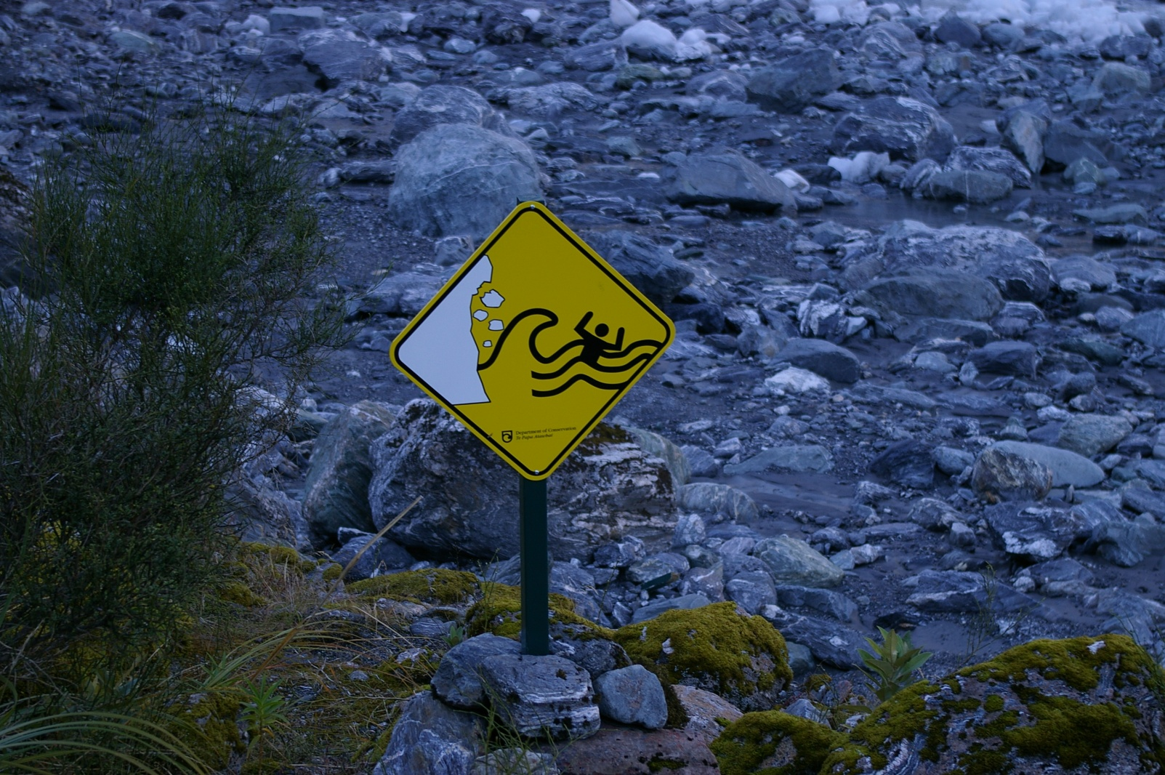
Any Questions?

Slide 8
More information…..
Jackie Le Fèvre jackie@magmaeffect.com
www.magmaeffect.com
www.minessence.net

